Slide 1
Principles of Testing
(Chapter 1)

Slide 2
Objectives
Knowing what constitutes “quality” and looking at means of achieving “quality”
Understanding the role of testing vis-à-vis other life-cycle activities
Comprehending the basic principles of testing
Principles of Testing
Slide : <number>

Slide 3
Question:
What is “quality”?
Principles of Testing
Slide : <number>

Slide 4
Two Different Interpretations of “Quality”
“Quality of design” or “grade quality”
  More features for more money
  E.g., A BMW vs Maruti 800
“Quality of conformance”
  How well does the product meet the “promised” needs?
Principles of Testing
Slide : <number>

Slide 5
Our Definition:
Quality of Conformance
“Quality” is meeting the requirements
consistently and predictably.
Principles of Testing
Slide : <number>

Slide 6
Objectives
Knowing what constitutes “quality” and looking at means of achieving “quality”
Understanding the role of testing vis-à-vis other life-cycle activities
Comprehending the basic principles of testing
Principles of Testing
Slide : <number>

Slide 7
Phases of Software Development (Not Necessarily Sequential!)
Requirements gathering
Design
Development
Testing
Deployment and maintenance
Principles of Testing
Slide : <number>

Slide 8
Our definition:
Quality of Conformance
When does quality start?
Principles of Testing
Slide : <number>

Slide 9
Quality During Various Phases…
HIGH
High rework costs
Ideal state!
LOW
HIGH
Effectiveness of testing phase
Quality of other phases
Not sustainable!
Risky!
LOW
Principles of Testing
Slide : <number>

Slide 10
Objectives
Knowing what constitutes “quality” and looking at means of achieving “quality”
Understanding the role of testing vis-à-vis other life-cycle activities
Comprehending the basic principles of testing
Principles of Testing
Slide : <number>

Slide 11
Principle #1
A product should meet the customers’ needs.
Customers need not be “external” customers.
  Testers are customers for developers.
  A software should be “testable.”
Testing should identify defects
before the customer finds them out!
Principles of Testing
Slide : <number>

Slide 12
Principle #1:
Implications
Practice of incorporating customer-supplied test cases into battery of tests
Including customers and / or “customer facing” into the testing functions
Concept of alpha / beta testing
Principles of Testing
Slide : <number>

Slide 13
Principle #2
The “triangle” problem
The “6-character” problem
Dijkstra’s doctrine:
Program testing can never prove the absence of bugs,
only their presence.
Principles of Testing
Slide : <number>

Slide 14
Principle #2:
Implications
Choose your tests intelligently.
Choose tests that have a higher probability of uncovering defects.
  Boundary values, choice of regression tests
Principles of Testing
Slide : <number>

Slide 15
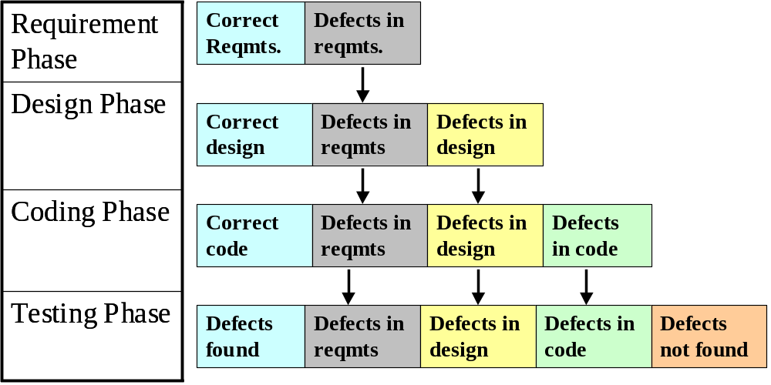
Principle #3
Principles of Testing
Slide : <number>

Slide 16
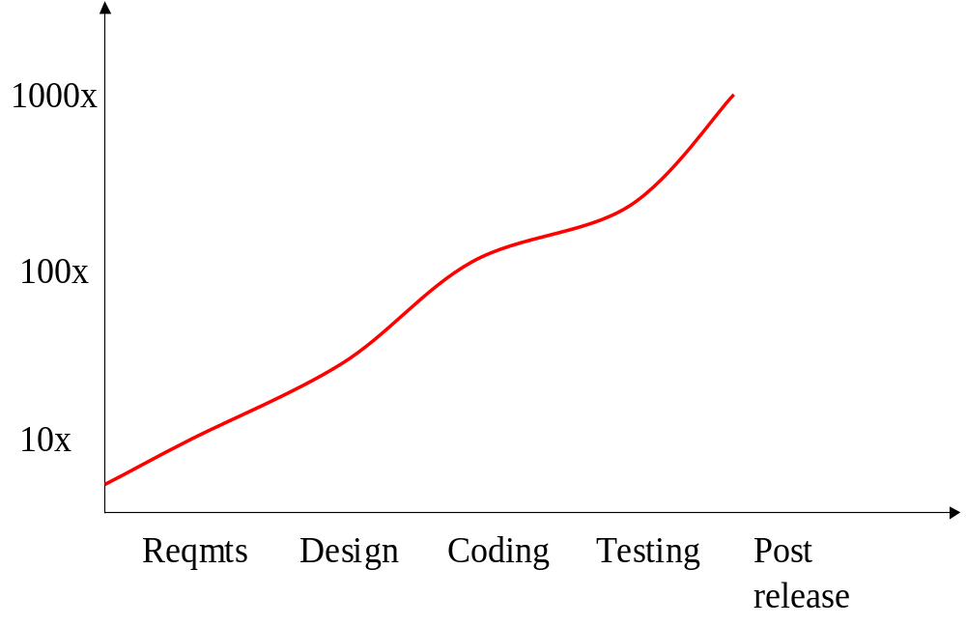
Principle #3
Defects should be detected and corrected at the earliest –
postponing detection of defects compounds cost!
Principles of Testing
Slide : <number>

Slide 17
Principle #3: Implications
Different types of testing interspersed in product cycle
Different methods of integration
Concept of regression testing
Principles of Testing
Slide : <number>

Slide 18
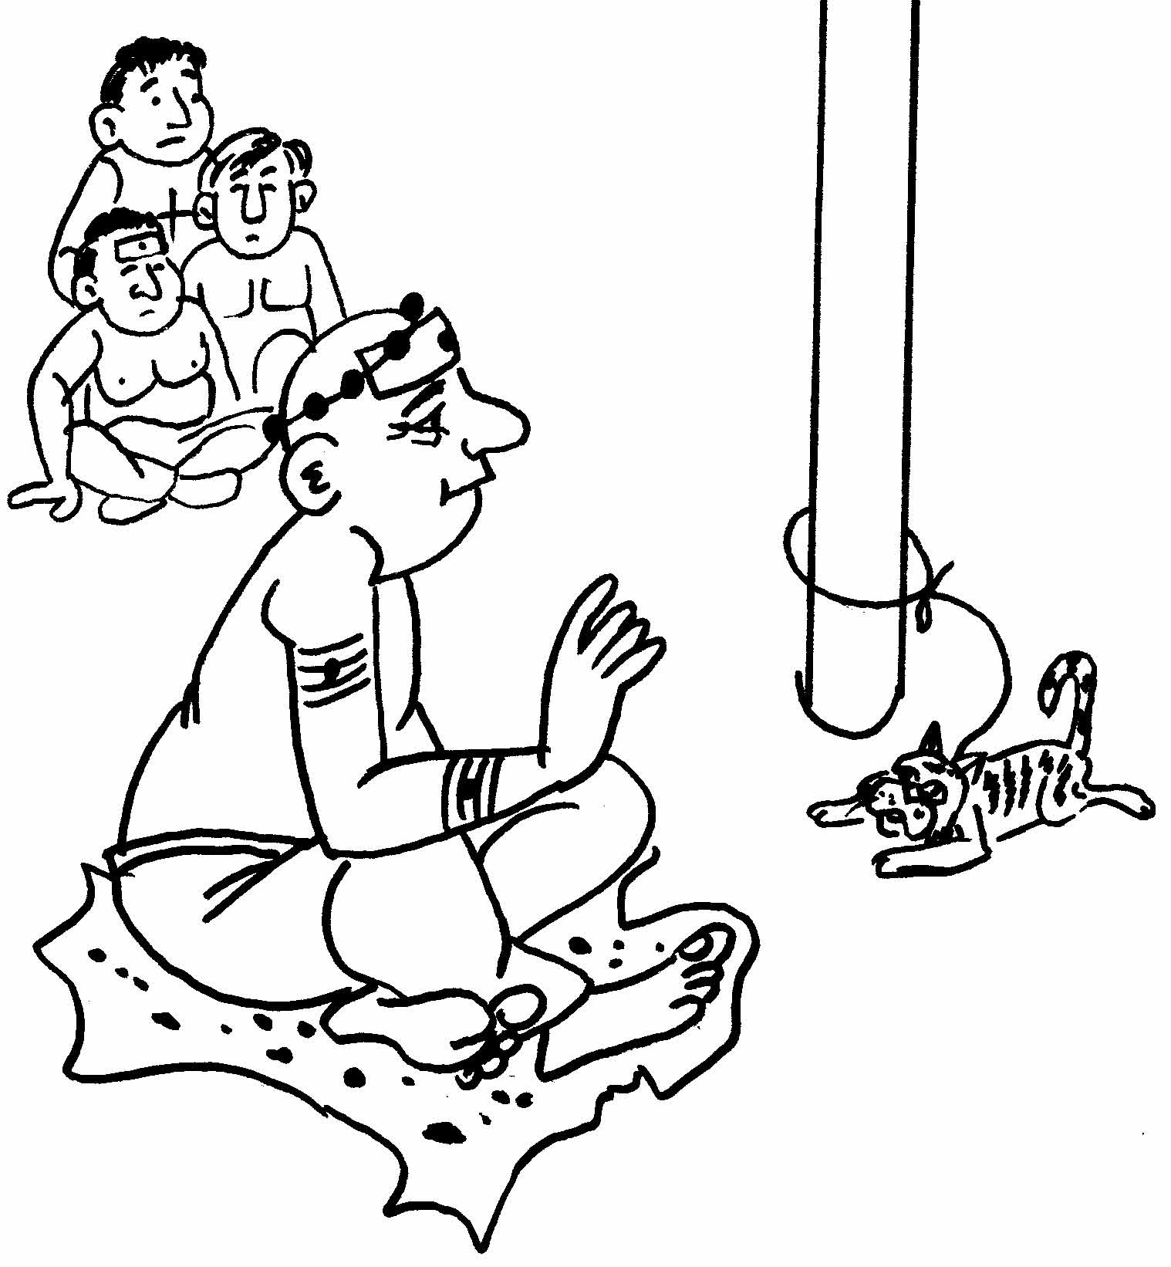
Principle #4:
The Cat and the Saint
Knowing why you are testing something is as important as
knowing what you are testing
Principles of Testing
Slide : <number>

Slide 19
Principle #4:
Implications
White box testing
  Starting from code
Black box testing
  Starting from external functionality
Integration testing
  Stuff works together!
System / performance testing
  Works in real-life conditions
Regression testing
  Makes sure changes don’t affect existing stuff
Domain / ad hoc testing
  Bringing domain expertise into testing
Principles of Testing
Slide : <number>

Slide 20
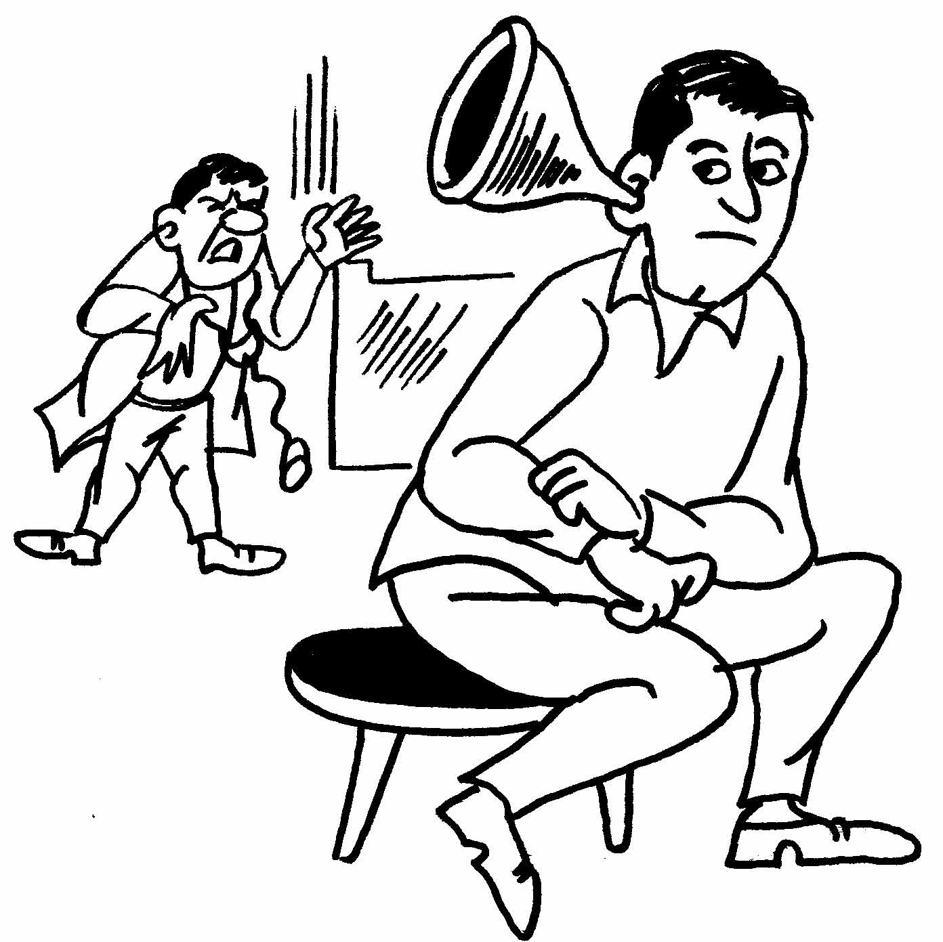
Principle #5
Test the tests first!
A defective test is even more dangerous than a defective product!
Principles of Testing
Slide : <number>

Slide 21
Principle #5:
Implications
A test should document the
  Input data
  Expected results
  Test process
The behaviour has to be externally corroborated.
  No Turing machine can verify itself!
Principles of Testing
Slide : <number>

Slide 22
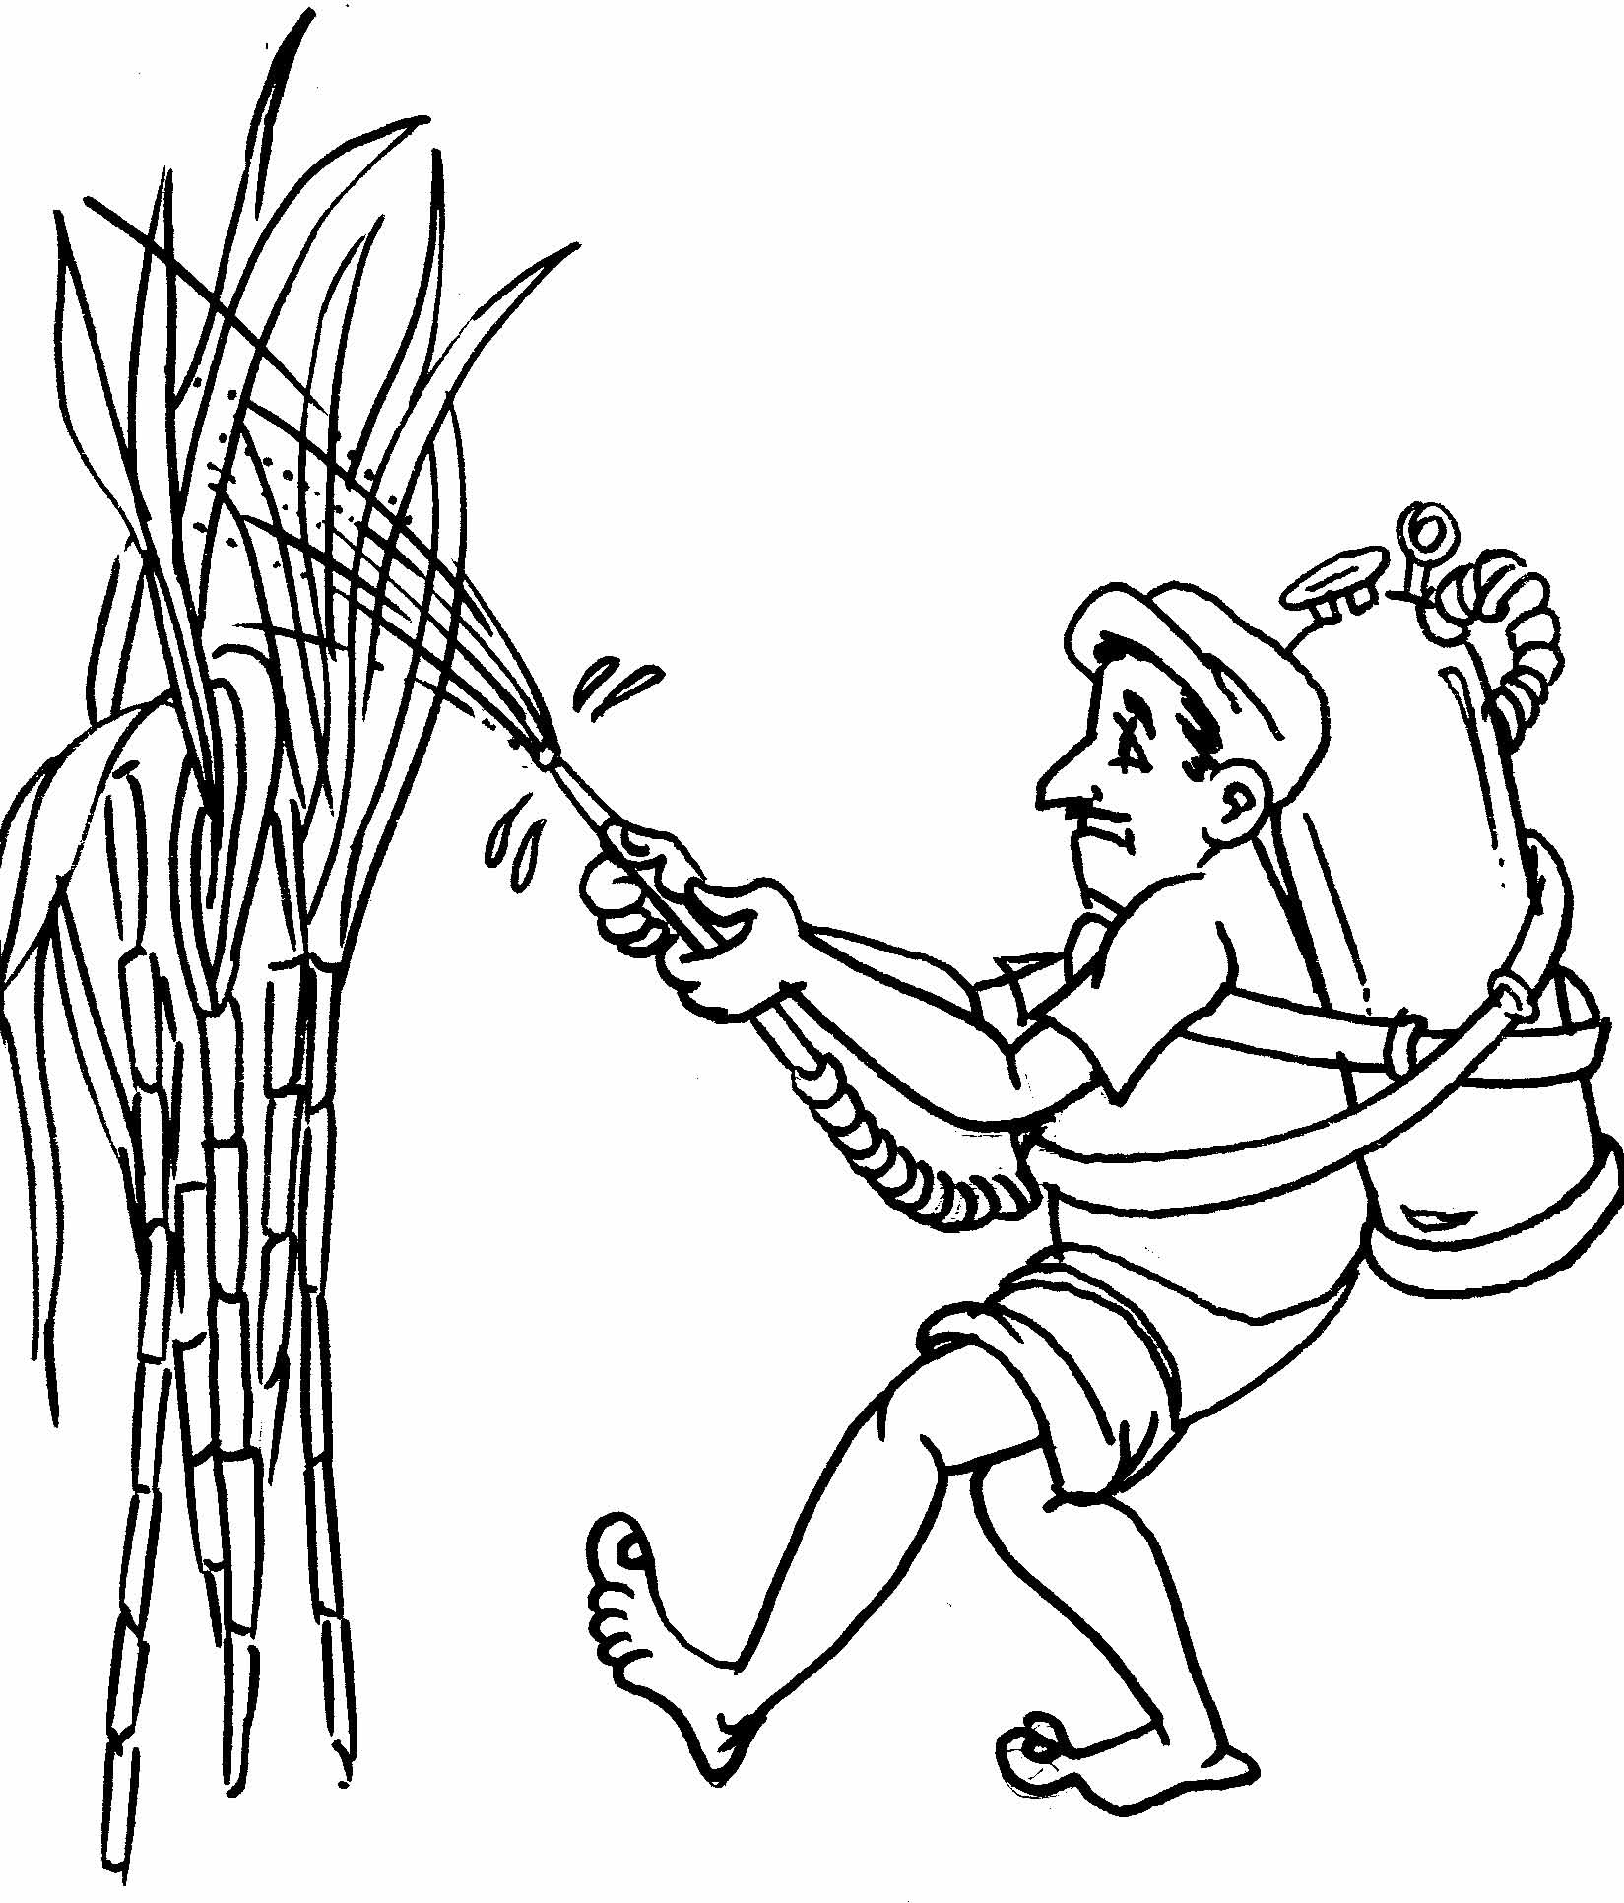
Principle #6:
The Pesticide Paradox
Bugs are like bacteria – they develop resistance to antibiotics;
new antibiotics have to be developed!
Principles of Testing
Slide : <number>

Slide 23
Principle #6:
Implications
We need to redefine and refine tests as we move forward.
As we “pass” old tests, new defects will surface.
Regression tests have to be “retired,” and new regression tests have to be designed.
Principles of Testing
Slide : <number>

Slide 24

Principle #7:
The Rags and the Convoy
Principles of Testing
Slide : <number>

Slide 25
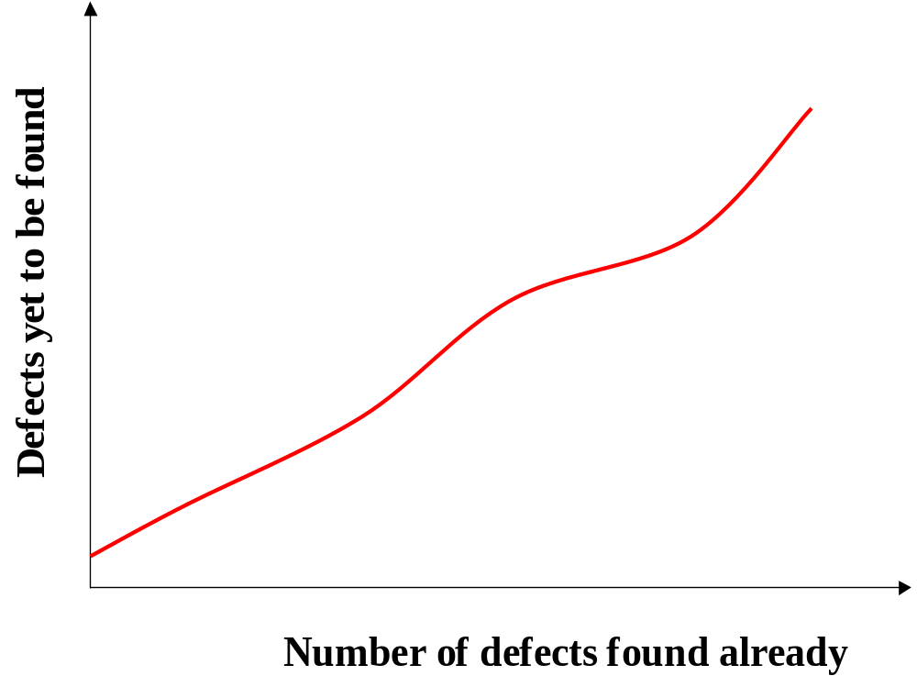
Principle #7:
Defects come in convoys ;
Fixing a defect in the convoy is likely to add more defects to it.
Principles of Testing
Slide : <number>

Slide 26
Principle #7:
Implications
Look for side effects.
Look for “spaghetti code” or “rags.”
Tie maintenance and testing functions closely.
Principles of Testing
Slide : <number>

Slide 27
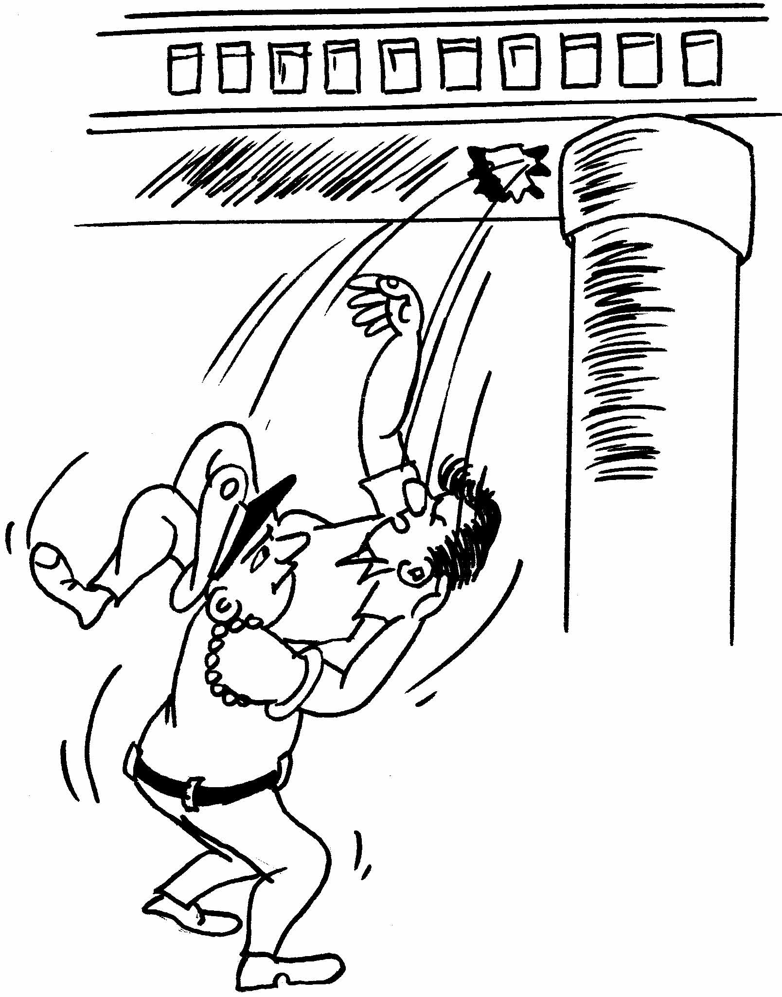
Principle #8:
Cop on the Bridge
Prevention is better than cure –
prevention can substantially open new vistas
Principles of Testing
Slide : <number>

Slide 28
Prevention and Cure:
Quality Assurance vs Quality Control
Quality assurance
  Process oriented
  Defect prevention oriented
  Proactive
  Staff function
Quality control
  Product oriented
  Defect detection / correction oriented
  Reactive
  Line function
Principles of Testing
Slide : <number>

Slide 29
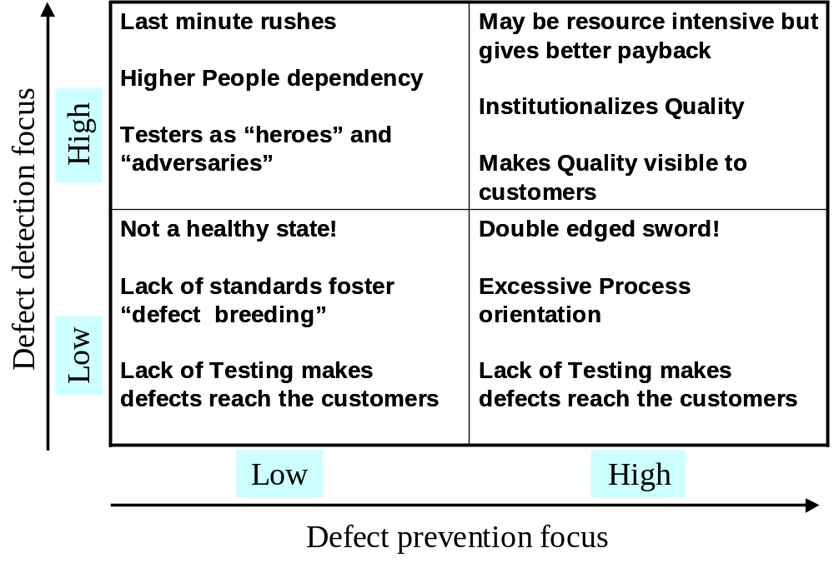
Principle #8 Leads to
Principle #9:
Principles of Testing
Slide : <number>

Slide 30
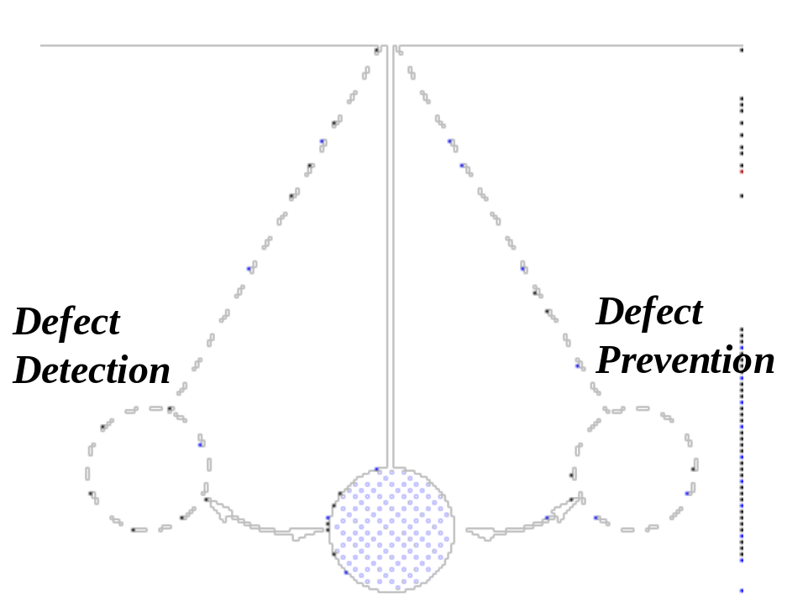
Principle #9:
Ends of a Pendulum
Principles of Testing
Slide : <number>

Slide 31
Principle #8 and #9:
Implications
Achieve a balance between defect prevention (quality assurance) and defect detection (quality control).
View QA and QC as supplementary and not adversary job functions.
Distribute QA / QC functions throughout for early detection (Principle #1).
Principles of Testing
Slide : <number>

Slide 32
Principle #10:
The Men in Black
The IBM experiment (Peopleware, DeMarco & Lister)
Issues of “pride” that we discussed in the previous class
Principles of Testing
Slide : <number>

Slide 33
Principle #10:
Implications
Instilling pride in testers
Establishing an identity for testers
Showing them a career path
Principles of Testing
Slide : <number>

Slide 34
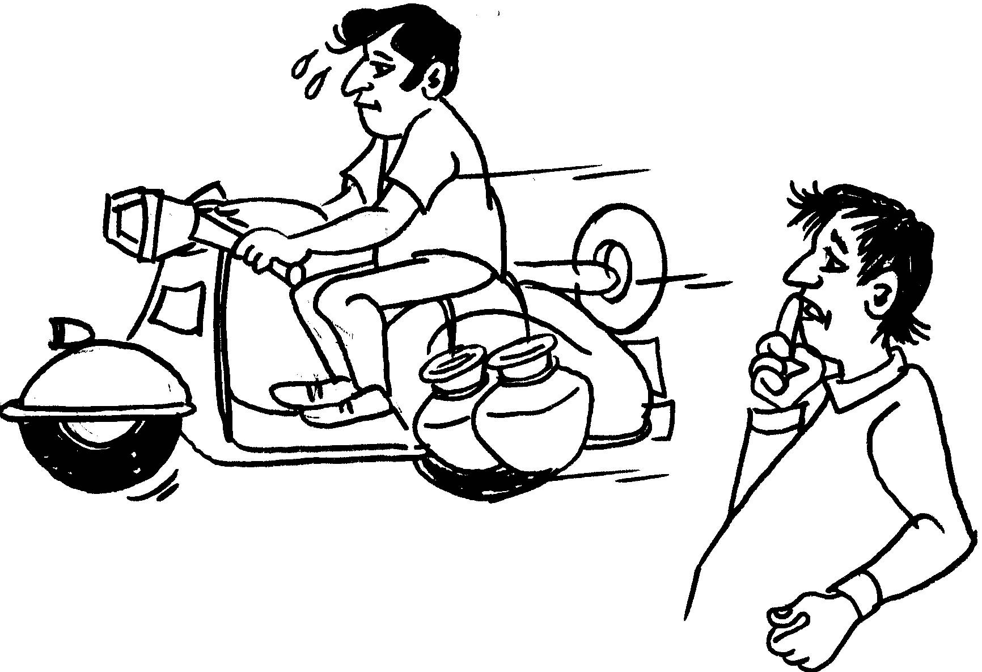
Principle #11:
Automation Syndrome
Focus on WHAT you want to automate;
relate it to the goals.
Remember: automation is not a panacea.
Principles of Testing
Slide : <number>

Slide 35
Putting It All Together…
#1: The goal of testing is to find defects BEFORE customers find them.
#2: Program testing can only show the presence of bugs, never their absence.
#3: Test early and often.
#4: Understand the “why” and not just the “what” / “how”.
#5: Test the tests first.
#6: Bugs develop immunity – discover new tests!
#7: Focus on convoys of defects.
#8: Testing encompasses defect prevention.
#9: Strike a fine balance between defect prevention and defect detection.
#10: Plan the automation initiatives.
#11: Instill pride in testers.
Principles of Testing
Slide : <number>

Slide 36
Objectives (Recap)
Knowing what constitutes “quality” and looking at means of achieving “quality”
Understanding the role of testing vis-à-vis other life-cycle activities
Comprehending the basic principles of testing
Principles of Testing
Slide : <number>

